Slide 1
Memory-Based Cluster Sampling for Remote Sensing Image Classification
Members: Kledi Kallastra

Slide 2
Introduction
The increase of spatial and spectral resolutions of remotely sensed images opens a wide range of potential applications in Earth observation tasks. Nonetheless, the issues of efficiency and performance of data processing algorithms arise, since models must be accurate and provide solutions that are robust to complex and high dimensional spaces. In this sense, kernel methods and in particular Support Vector Machines (SVM) have known increasing success in hyperspectral and multispectral image classification.
In the machine learning literature this approach to sampling is known as active learning. Active learning is defined as the iterative procedure of selecting from a subset of unlabeled samples the most informative examples. This choice is based on a ranking score computed thanks to the model outcome, the chosen candidates are presented to the user, who is asked for their labeling, and then are included into the training set.

Slide 3
The selection criteria for active learning are based on the efficient reduction of the hypothesis space, by evaluating the uncertainty of the classifier on the pool of unlabeled examples. The concept of uncertainty is crucial for the definition of Active Learning heuristics and can be roughly defined as the reciprocal of the confidence of a classifier on the label assignment on a given set of samples.
Margin-based classifiers such as SVM are well-suited candidates to active learning: the distance to the separating hyperplane, i.e., the value of the decision function, provides a straightforward way to estimate the classifier confidence on a set of candidates. Since SVM relies on a sparse representation of the training samples, this family of heuristics aims at completing this set by adding the most uncertain samples more likely to become support vectors, i.e., the samples receiving a non-zero coefficient contributing to the classification solution.
Even if yielding to good performances when selecting a single example per iteration, heuristics based on the sole distance to the margin are suboptimal when faced to the sampling of batches of samples. Although avoiding proximal sampling problem, this restriction does not enhance the exploration of the SVM margin through iterations (dense sampling or low exploration problem hereafter): MS-cSV only samples in the proximity of current support vectors and thus cannot discover areas of the margin that are poorly described by the current data.
In this paper we extend this last idea proposing two improved active sampling criteria. In the kernel induced feature space, points are first selected as a function of their estimated uncertainty with respect to their class assignments and then grouped by means of nonlinear clustering.

Slide 4
ACTIVE LEARNING METHODS FOR SUPPORT VECTOR MACHINES
This section briefly reviews the kernel trick and SVM, then introduces active learning heuristics.
The kernel trick:
Let φ(·) : X → H be the smooth and continuous mapping function from the input space to a higher dimensional Reproducing Kernel Hilbert Space H (RKHS). Also, let (φ(·), φ(·)) be the dot product quantifying the similarity of the examples in H. Usually, neither the space H∗ providing the best solution nor the mapping function φ∗(·) to that specific space are known in advance, making the search of the optimal space infeasible. In order to solve this issue, the inner product between the (explicit) mapped patterns is replaced by a kernel function k(x_{i}, x_{j} ) = (φ(x_{i}), φ(x_{j})) that implicitly maps the samples from the original space X into H, computes the dot product and returns this value. By implicitly, it is meant that only the patterns in the original input space are required.
This is known as the kernel trick

Slide 5
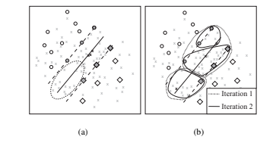

Support vector machines classifier
Support vector machines are a nonparametric classifier based on Vapnik’s statistical learning theory. To achieve non-linear separation, SVM build a linear decision function in the higher dimensional feature space H where the samples are more likely to be (linearly) separable. This mapping is implicitly performed using kernel functions, and, when using non-linear mappings, a linear separation in H corresponds to a non-linear separation in the input space.
0 $≤$ $α$ $≤$ C and $\sum_{i}^{l}{α_{i}y_{i}}$ = 0
The solution gives rise to the following $α$ values:
$α_{i}$ = 0: $x_{i}$ is classified on the correct side of the margin ($y_{i}f\left(x_{i}\right)>1$), with an associated $ε_{i}$ = 0. most of the $α$ coefficients will belong to this case, implementing the sparsity of the SVM solution.
In (a) the MS approach [35] shows potential high proximity redundancy when sampling a batch 3 of points, avoiding sampling from a large zone in the margin (dashed ellipse) and in (b) the baseline of proposed approach that aims at removing any kind of redundancy among patterns.

Slide 6

Margin sampling based active learning and the evaluation of uncertainty
As stated in the introduction, the MS heuristic for active learning takes directly advantage of the distance from the SVM margin given by f(x’) = $\sum_{i}^{l}{α_{i}}y_{i}k\left(x_{i}, x^{′}\right)+b$.
If we now consider the ensemble of unlabeled candidates (U), we can assume that those that may receive a non-zero $α$ coefficient if added to the training set are the samples that fall within the margin of the current classifier. The candidates to be included in the training set satisfy the following heuristic: ${\hat{x}}^{MS}= {argmin}_{x_{i}∈U}g(x_{i})$, where g($x_{i}$) = $\min_{y∈Y} |f_{y}(x_{i})|$, where $f_{y}$(·) is the decision function of the One-Against-All (OAA) SVM subproblem. Recall that the multiclass OAA architecture builds |Y| binary SVM and assigns the class membership based on the highest confidence. This way, the information about absolute sample uncertainty can be summarized in a unidimensional measure, g(x_{i}).

Slide 7
DATASETS AND EXPERIMENTAL SETUP
Datasets:
VHR: the first dataset is a 0.6 m spatial resolution multispectral pansharpened QuickBird image of a portion of the city of Zurich (Switzerland) acquired in 2002. The image presents 5 different classes of built and natural environments. A total of 75972 samples are used for testing and 20050 patterns are included in the pool of candidates U⁰. The initial training sets X¹ are composed of 5 examples per class, randomly drawn from U⁰.
Hyperspectral: the second image was acquired by the NASA AVIRIS sensor over the Kennedy Space Center (KSC) in Florida, U.S.A, in 1996. It has a spatial resolution of about 18 m. This sensor produces a 224 bands of 10 nm width. Here, low Signal-to-Noise ratio and water absorption bands are removed resulting in 176 bands. 13 ground cover classes were considered resulting in 5211 examples. The U⁰ set is composed of 3800 samples and the independent test set by 1411 pixels. The 3800 U⁰ set was also used in order to evaluate the full SVM performance.

Slide 8
Experimental setup
For all the experiments, the comprehensive labeled set has been divided in two parts: the first part defines the sets X and U, while the second (the test set) has been used for validation purposes and it is the same for all the experiments on a same image. The starting training set X¹, was randomly extracted from U⁰ (the initial pool of candidates at iteration = 0). The remaining candidates, after hiding their labels, compose the pool of candidates U¹. For each independent run, a 5-fold cross validation has been carried outin order to choose an initial set of hyperparameters in the ranges C = [1, 10, 20, ..., 600] and
σ = [0.5 × σp , σp , 1.5 × σp], where σp is equal to the average euclidean distance between
randomly chosen pixels in U⁰. These hyperparameters are then kept throughout the experiment. Empirical observations showed that the re-evaluation of the kernel parameter and of the SVM penalization term C during iterations do not affect the average convergence rate.
The parameters of the methods are set as follows: for the VHR case study the hCS parameters are θ = 0.25 for hCS-s and hCS-i1, θ = 0.5 for hCS-i2 and hCS-i3. In order to allow fair comparison, ECBD is run with the same θ as for the hCS-s approach. For the hyperspectral experiment, the θ parameter of hCS-s and ECBD is equal to 1. For hCS-i1, hCS-i2 and hCS-i3, the θ are 1, 2 and 2 respectively. The hCS parameters were chosen based on a percentage of the uncertain samples that will be included in the clustering step. The hCS-i2 and hCS-i3 heuristics need larger thresholds θ since the search they perform needs more candidates: the former simply extends the hypothesis space, the latter considers more iterations resulting in a refined search among clustered samples. Another way of selecting θ is based on the visual inspection of the histogram of the uncertainty score of the samples in the pool of candidates at the first iteration: considering this histogram, the user can define a parameter θ that includes the high-density region corresponding to low values of the uncertainty criteria.

Slide 9

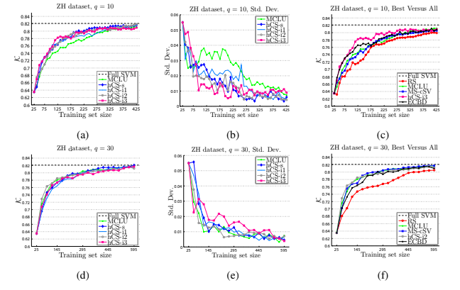
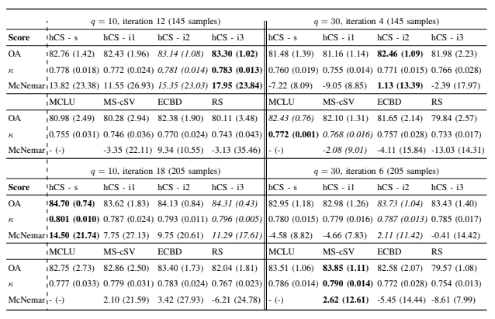
RESULTS AND DISCUSSION
Zurich dataset: VHR imagery:
Learning curves for the ZH dataset: (a) the proposed approaches sampling 10 samples per iteration and in (b) theirstandard deviation. In (c) the best approach against state-of-the-art AL algorithms. In (d), (e) and (f) the same plots sampling30 pixels per iteration.
Table 1 summarizes skills scores for the experiments when the training set is composed by 145 and 205 samples. For the first case and when sampling small batches (left column, q = 10), the memory of already sampled pixels can greatly improve the generalization ability of the classifier.

Slide 10
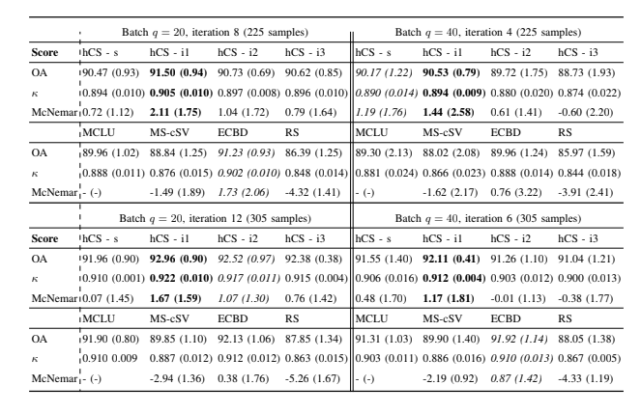
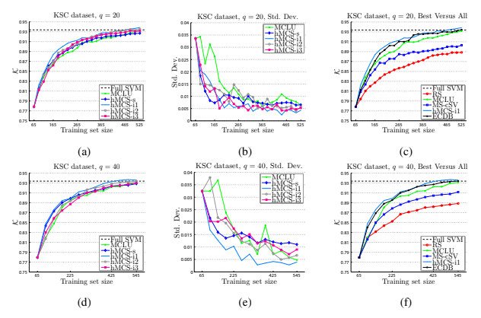
KSC dataset: hyperspectral imagery
The hyperspectral case study is characterized by a full SVM estimated κ statistic of 0.934. The active learning heuristics with q = 20 reached this accuracy after sampling 445 pixels (19 iterations, hCS-i1 and hCS-i2), 485 (21 iterations, ECBD and hCS-i3) and 525 (23 iterations, MCLU). The same trends are observed when sampling 40 pixels per iteration.
Considering the q = 20 experiment shown in Fig. 4(a), all the proposed methods and the MCLU result in similar average accuracies, except for hCS-i1, that performs slightly better between the 4th and the 11th iteration. From iteration 11 on, all the memory-based approaches show similar performances. The q = 40 curves shown in Fig. 4(d) illustrate again the good performance of the hCS-i1.
Regarding standard deviations values with q = 20 (curves Fig.4(b)) the hCS-s, hCS-i1 and hCS-i3 are the approaches that show the faster decrease (in 5 and 6 iterations). After iterations 12-13 standard deviation values are stable, and the hCS-i1 demonstrates its good performance by providing, together to the hCS-i3, the most stable solutions for most of the iterations. The q = 40 standard deviation curves (Fig.4(e)) show that the hCS-i1 provides again the most stable solution. This is the only method providing a standard deviation similar to the one observable with the smaller batch (q = 20).
In Fig. 4(c) and 4(f) the best hCS heuristic is compared to other state of the art methods. The best approach is the hCS-i1 that slightly outperforms in the first iterations the ECBD. At convergence, all the cluster-based approaches perform similarly. It is worth recalling that the MS-cSV is the only active method that does not exploit the uncertainty criteria adopted by the other approaches and it is really indicative on the ability of the MCLU to evaluate uncertainty (see e.g., the results in [25]).
Table II summarizes and compares the approaches, for the two batch sizes, after sampling 225 and 305 pixels. For the smaller batch (q = 10, X = 225), the only method significantly better than MCLU is the hCS-i1, followed by the ECBD method (performing only slightly better than MCLU). For the larger batch (q = 30), results shows generally similar accuracies and again the hCS-i1 performs better than the other methods (this time no method is statistically better than the MCLU). When the training set is composed by 305 samples, the batch composed by 40 pixels show better performances for the hCS-1 and hCS-i2, but not significantly better than the baseline MCLU. For a training set composed by 305 samples the observations are similar. Summing up, methods exploiting memory and diversity in sampling converge faster and better than the other state of the art methods tested in this experiment.

Slide 11
CONCLUSIONS
In this paper, two approaches to active learning have been presented. These approaches exploit clustering in the feature space spanned by the kernel function of the SVM to prevent redundancy when selecting a batch of points: first, the proximity of sampling (low diversity) is avoided by exploring the set of uncertain candidates with the hierarchical clustering implemented using kernel k-means algorithm. Secondly, the proposed approaches (in particular the hCS-i) can solve regions where the classes are strongly overlapping, discarding regions of the feature space prone to provide uninformative pixels for the classification problem (i.e., a cluster that contains a pixel sampled at the previous iterations). In case of redundancy, sampling is forced to move either to unexplored or underexplored areas, where examples are needed to learn improved classification boundaries. In particular hCS-i has demonstrated its effectiveness by competing with state-of-the-art methods and introducing in the active learning framework a temporal component through memory. By controlling pixels sampled in last iterations the convergence to adequate accuracies is boosted, especially in firsts iterations. Summing up, the inclusion of the memory in the active learning framework successfully tackles the problem of lack in exploration during the iterations, while the cluster-based sampling systematically avoids proximal sampling returning diversified batches. For the tested datasets, memory based active learning showed the steepest increases in accuracy: different parameters defining the capacity of the memory and the degree of exploration showed promising results.
It results clearly that the best solution in terms of AL solution is not given by a single universal method. The different tested approaches show different convergence rates depending on the data at hand and the degree of complexity of the images. In order to achieve the best convergence, future research has to deal with the combination of criteria, and the memory-based framework for active learning seems thus an appropriate tool for combining informative sampling with user specific prior knowledge about the data controlling the constraints defining cluster redundancy. Additional efforts should also account for dynamical adaptation of the thresholds and parameters of the active learning process, as θ and in particular γ. By varying those parameters during the active learning process, the algorithm can tune itself by encoding information about the data structure in its free parameters, resulting in optimal sampling schemes. More efforts should also be included in the inclusion of regularization terms in order to avoid sampling noise and atypical pixels.

